Slide 1
ADTS, STACKS AND QUEUES

Slide 2
Abstract Data Type (ADT)
An abstract data type is a data declaration packaged together with the operations that are meaningful on the data type (composite types).
In other words, we encapsulate the data and the operation on data and we hide them from the user.
ADT has
  Declaration of data (set of values on which it operates)
  Declaration of operation( set of functions)
  and hides the representation and implementation details

Slide 3
Array as Abstract Data Type
ADT Array
objects: A set of pairs <index, value> where for each value of index there is a value from the set item. Index is a finite ordered set of one or more dimensions, for example, {0, … , n-1} for one dimension, {(0,0),(0,1),….,….,(2,1),(2,2)} for two dimensions,
etc.
Functions: for all A ∈ Array, i ∈ index, x ∈ item, j, size ∈ integer
  Array Create(j, list) ::= return an array of j dimension where list is a
  j-tuple whose ith element is the size of ith dimension
  Item Retrieve(A, i) ::= if i ∈ index retrieve the element from array A indexed
  by i
  Array Store(A, i, x) ::= if i ∈ index store the value x at ith index in the array A
End Array

Slide 4
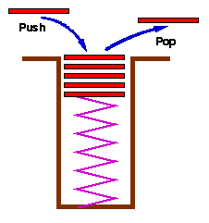
Stacks
Definition: A Stack (Linear data structure )is an ordered list in which insertions and deletions are made at one end called the top.
Insertion is called as PUSH
Deletion of an element is called as POP
Stack is also called as Last In First Out (LIFO) list.

Slide 5
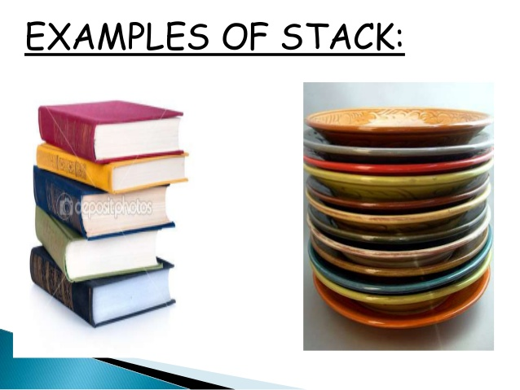

Slide 6
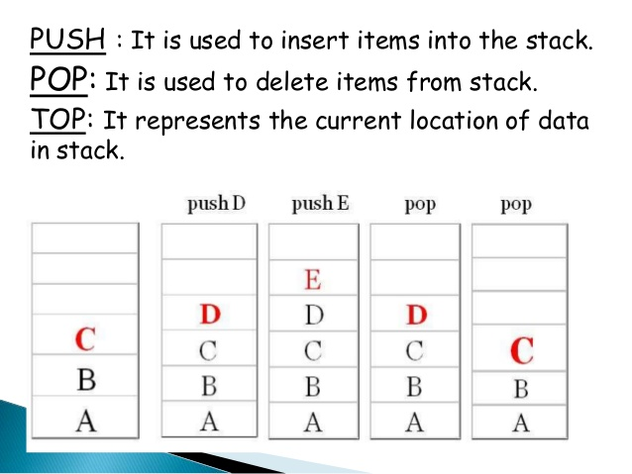

Slide 7
stack: a Last-In-First-Out (LIFO) list
B
A
C
B
A
D
C
B
A
E
D
C
B
A
top
D
C
B
A
top
top
top
top
A
top
Top=-1
*Figure 3.1: Inserting and deleting elements in a stack (p.102)

Slide 8
Abstract Data Type for stack
ADT Stack is
objects: a finite ordered list with zero or more elements.
functions:
for all stack ∈ Stack, item ∈ element, max_stack_size
∈ positive integer
Stack CreateS(max_stack_size) ::=
create an empty stack whose maximum size is
max_stack_size
Boolean IsFull(stack, max_stack_size) ::=
if (number of elements in stack == max_stack_size)
return TRUE
else return FALSE
Stack Push(stack, item) ::=
if (IsFull(stack)) stack_full
else insert item into top of stack and return

Slide 9
Boolean IsEmpty(stack) ::=
if( Number of elements are 0)
return TRUE
else return FALSE
Element Pop(stack) ::=
if(IsEmpty(stack)) return
else remove and return the item on the top
of the stack.

Slide 10
Operations on a Stack
The following operations are performed on the stack...
Push (To insert an element on to the stack)
Pop (To delete an element from the stack)
Display (To display elements of the stack)
Stack data structure can be implemented using:
Using Array
Using Linked List
When a stack is implemented using an array, that stack can organize an only limited number of elements.
When a stack is implemented using a linked list, that stack can organize an unlimited number of elements.

Slide 11
#include<stdio.h>
#define stackSize 4
void push(char element, char stack[], int *top)
{
if(*top == stackSize-1)
{printf("\Stack Full\n");
return;}
stack[++(*top)] = element;
}
void pop(char stack[], int *top){
if(*top == -1)
{
printf("\nThe stack is empty. \n");
return;}
printf("Element popped: %c \n", stack[(*top)--]);
}

Slide 12
printf("Element on top: %c\n", stack[top]);
pop(stack, &top);
printf("Top: %d\n", top);
pop(stack, &top);
pop(stack,&top);
printf("\n");
push('a', stack, &top);
push('b',stack, &top);
push('c', stack, &top);
push('d', stack, &top);
push('e',stack, &top);
return 0;
}
int main() {
char stack[stackSize];
int top = -1,i;
push('a', stack, &top);
push('b',stack, &top);
push('c', stack, &top);
for(i=top;i>=0;i--)
printf("%c\n", stack[i]);
printf("Top: %d\n", top);
pop(stack, &top);

Slide 13
c
b
A
Top: 2
Element popped: c
Element on top: b
Element popped: b
Top: 0
Element popped: a
The stack is empty.
Stack Full

Slide 14
Implementation: using array
Stack CreateS(max_stack_size) ::=
#define MAX_STACK_SIZE 100 /* maximum stack size */
typedef struct {
int key;
/* other fields */
} element;
element stack[MAX_STACK_SIZE];
int top = -1;

Slide 15
Implementation: using array
Stack CreateS(max_stack_size) ::=
#define MAX_STACK_SIZE 100 /* maximum stack size */
typedef struct {
int key;
/* other fields */
} element;
element stack[MAX_STACK_SIZE];
int top = -1;
Boolean IsEmpty(Stack) ::= top< 0;
Boolean IsFull(Stack) ::= top >= MAX_STACK_SIZE-1;

Slide 16
Add to a stack
void push(int top, element item)
{
/* add an item to the global stack */
if (top >= MAX_STACK_SIZE-1) {
stack_full( );
}
stack[++top] = item;
}

Slide 17
Add to a stack
void push(int top, element item)
{
/* add an item to the global stack */
if (top >= MAX_STACK_SIZE-1) {
stack_full( );
}
stack[++top] = item;
}
Void stack_full()
{
fprintf(stderr, “Stack is full, cannot add element”);
exit(EXIT_FAILURE);
}

Slide 18
element pop(int *top)
{
/* return the top element from the stack */
if (top == -1)
return stack_empty( ); /* returns and error key */
return stack[(top)--];
}
Delete from a stack

Slide 19
#include<stdio.h>
#define max 6
typedef
{
int stack[max];
int top;
}STACK;
int empty(STACK *s)
{
if(s->top == -1)
{
return(1);
}
return(0);
}
int full(STACK *s)
{
if(s->top == max-1)
{
return(1);
}
return(0);
}
void push(STACK *s, int x)
{
s->top = s->top+1;
s->stack[s->top]=x;
}

Slide 20
int pop(STACK *s)
{
int x;
x=s->stack[s->top];
s->top=s->top-1;
return(x);
}
void print(STACK s)
{
int i;
for(i=s.top;i>=0;i--)
{
printf("%d\t",s.stack[i]);
}
}
void main()
{
STACK s;
int ch,x;
s.top=-1;
do{
printf("1.push\n2.pop\n3.dispaly\n4.exit\n");
printf("enter your choice\n");
scanf("%d",&ch);

Slide 21
switch(ch)
{
case 1:printf("enter value\n");
scanf("%d",&x);
if(!full(&s))
push(&s,x);
else printf("Stack is overflow\n"); break;
case 2:if(!empty(&s))
{
x=pop(&s);
printf("popped is %d\n",x);
printf("\nRemaining elements:");
print(s);
}
else printf("stack is empty\n"); break;
case 3:print(s); break;
}}while(ch!=4);}

Slide 22
Stack Applications
Expression conversion
  Infix (a+b*c) a+b*c^d^e
  Prefix(+a*bc)
  Postfix(abc*+)
Evaluation of expression
  1+2*3→ 123*+→16+→7
Used to check parenthesis matching in an expression.
a+(b-c*(d-e)/f)-g →push( ( ),push( ( ) pop pop
Recursion handling

Slide 23
Use of Stacks in Function call – System Stack
Whenever a function is invoked program creates a structure called activation record or a stack frame and places it on top of system stack.
Initially, the activation record for the invoked functions contains only a pointer to the previous frame and return address.
The previous stack frame pointer points to the stack frame of invoking function.

Slide 24
Use of Stacks in Function call – System Stack
While return address contains the location of the statement to be executed after the function terminates.
Only one function executes at given time which is the top of stack.
If this function invokes another, the non-static local variables parameters of invoking function are added to stack frame.

Slide 25
Stacks in Function call – System Stack
Assume that main() invokes function a1.
It creates stack frame for a1.
Frame pointer is a pointer to the current stack frame
Also system maintains separately a stack pointer
When a function terminates its stack frame is removed
Processing of invoking which is on top of stack continues

Slide 26
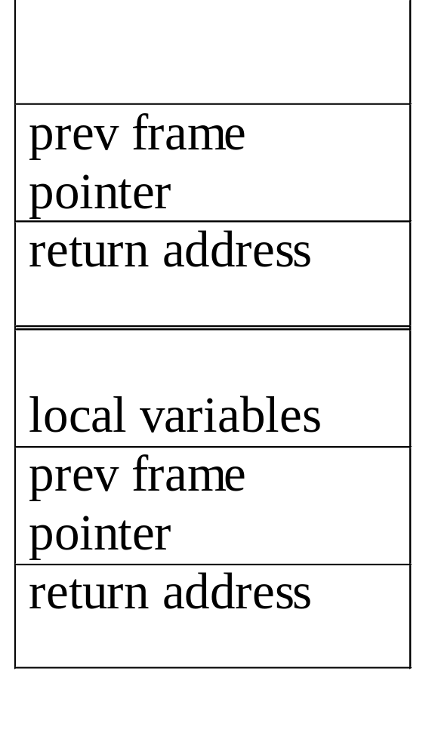
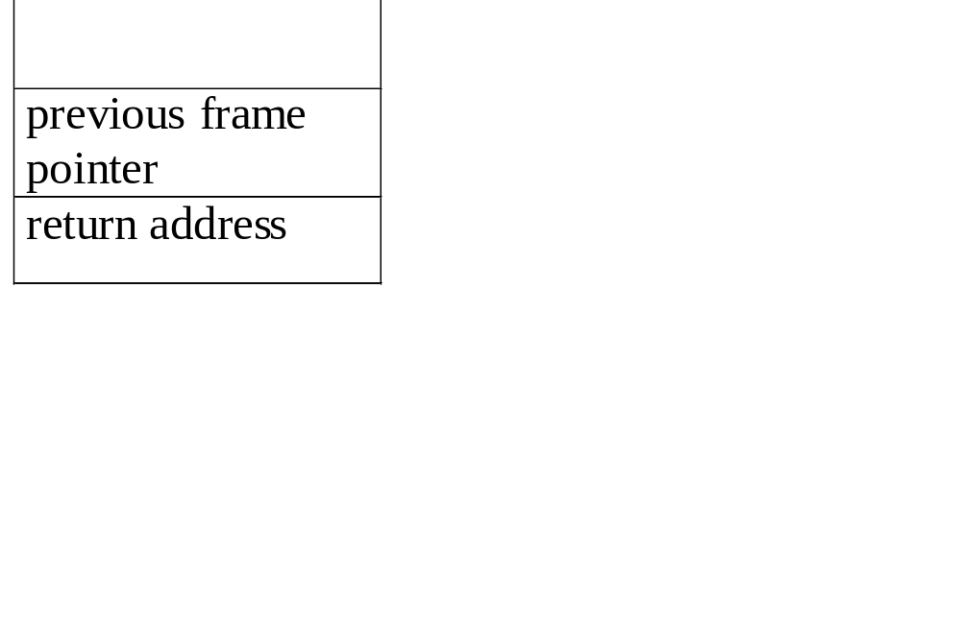
An application of stack: stack frame of function call
(activation record)
fp: a pointer to current stack frame
fp
al
fp
main
stack frame of invoking function
system stack before a1 is invoked
(a) (b)
System stack after function call a1
system stack after a1 is invoked

Slide 27
Stack using Dynamic Arrays

Slide 28
Stack using Dynamic Arrays
element *stack= (element *) malloc(sizeof(element));
int capacity=1; //replace MAX_ITEM_SIZE
Void StackFull()
{
Stack = (element *) realloc(2*capacity, sizeof(element));
capacity *=2;
}

Slide 29
Queues
Definition: A queue is an ordered list in which insertions and deletions takes place at different ends.
New elements are added to rear end
Old elements are deleted from front end
Since first element inserted is the first element deleted queues is also known as First-In-First-Out (FIFO ) lists.

Slide 30
Queue: a First-In-First-Out (FIFO) list
A
B
A
C
B
A
D
C
B
A
rear
front
D
C
B
rear
front
rear
front
rear
front
rear
front
*Figure 3.4: Inserting and deleting elements in a queue (p.106)

Slide 31
Queues - Application
Used by operating system (OS) to create job queues.
If OS does not use priorities then the jobs are processed in the order they enter the system

Slide 32
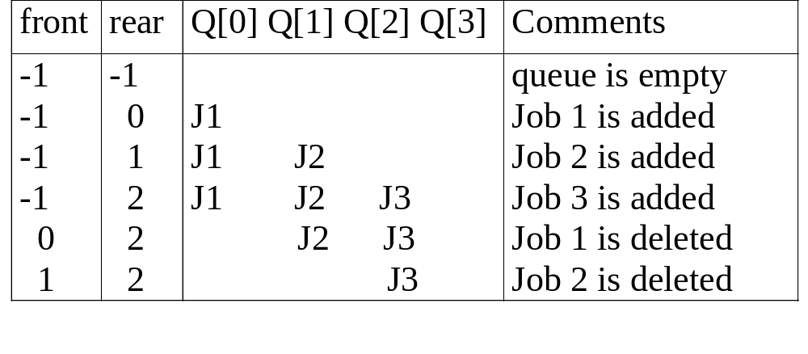
Application: Job scheduling
*Figure 3.5: Insertion and deletion from a sequential queue (p.108)

Slide 33
Abstract data type of queue
structure Queue is
objects: a finite ordered list with zero or more elements.
functions:
for all queue ∈ Queue, item ∈ element,
max_ queue_ size ∈ positive integer
Queue CreateQ(max_queue_size) ::=
create an empty queue whose maximum size is
max_queue_size

Slide 34
Implementation 1: using array
Queue CreateQ(max_queue_size) ::=
# define MAX_QUEUE_SIZE 100/* Maximum queue size */
typedef struct {
int key;
/* other fields */
} element;
element queue[MAX_QUEUE_SIZE];
int rear = -1;
int front = -1;

Slide 35
Abstract data type of queue
Boolean IsFullQ(queue, max_queue_size) ::=
if(number of elements in queue == max_queue_size)
return TRUE
else return FALSE
Queue AddQ(queue, item) ::=
if (IsFullQ(queue)) queue_full
else insert item at rear of queue and return queue

Slide 36
Implementation 1: using array
Boolean IsFullQ(queue) ::= rear == MAX_QUEUE_SIZE-1

Slide 37
void addq(int *rear, element item)
{
/* add an item to the queue */
if (*rear == MAX_QUEUE_SIZE_1) {
queue_full( );
return;
}
queue [++*rear] = item;
}
*Program 3.3: Add to a queue (p.108)
Add to a queue

Slide 38
Boolean IsEmptyQ(queue) ::=
if (queue ==CreateQ(max_queue_size))
return TRUE
else return FALSE
Element DeleteQ(queue) ::=
if (IsEmptyQ(queue)) return
else remove and return the item at front of queue.
*Structure 3.2: Abstract data type Queue (p.107)

Slide 39
Implementation 1: using array
Boolean IsEmpty(queue) ::= front == rear

Slide 40
element deleteq(int *front, int rear)
{
/* remove element at the front of the queue */
if ( *front == rear)
return queue_empty( ); /* return an error key */
return queue [++ *front];
}
*Program 3.4: Delete from a queue(p.108)
Delete from a queue

Slide 41
problem:
there may be available space when IsFullQ is true
i.e.. movement is required.

Slide 42
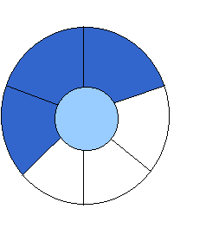
Implementation 2: regard an array as a circular queue
front: one position counterclockwise from the first element
rear: current end
EMPTY QUEUE
[2]
[3] [2] [3]
J2
J3
[1] [4] [1] [4]
J1
[0] [5] [0] [5]
front = 0 front = 0
rear = 0 rear = 3
*Figure 3.6: Empty and nonempty circular queues (p.109)

Slide 43

Problem: one space is left when queue is full
FULL QUEUE FULL QUEUE
[2] [3] [2] [3]
J2 J3
J8 J9
J7
[1] [4][1] [4]
J1 J4
J5
J6 J5
[0] [5] [0] [5]
front =0
rear = 5
front =4
rear =3
*Figure 3.7: Full circular queues and then we remove the item (p.110)

Slide 44
void addq(int front, int *rear, element item)
{
}
*Program 3.5: Add to a circular queue (p.110)
Add to a circular queue

Slide 45
void addq(int front, int *rear, element item)
{
/* add an item to the queue */
*rear = (*rear +1) % MAX_QUEUE_SIZE;
if (front == *rear) /* reset rear and print error */
return;
}
queue[*rear] = item;
}
*Program 3.5: Add to a circular queue (p.110)
Add to a circular queue

Slide 46
Delete from a circular queue
element deleteq(int* front, int rear)
{
}
*Program 3.6: Delete from a circular queue (p.111)

Slide 47
Delete from a circular queue
element deleteq(int* front, int rear)
{
element item;
/* remove front element from the queue and put it in item */
if (*front == rear)
return queue_empty( );
/* queue_empty returns an error key */
*front = (*front+1) % MAX_QUEUE_SIZE;
return queue[*front];
}
*Program 3.6: Delete from a circular queue (p.111)

Slide 48
Circular Queue: full = = rear condition
FULL QUEUE FULL QUEUE
[2] [3] [2] [3]
J2 J3
J8 J9
J7
[1] [4][1] [4]
J1 J4
J5
J6 J5
[0] [5] [0] [5]
front =0
rear = 5
front =4
rear =3

Slide 49
Circular Queue using Dynamically Allocated Arrays
FULL QUEUE FULL QUEUE
[2] [3] [2] [3]
J2 J3
J8 J9
J7
[1] [4][1] [4]
J1 J4
J5
J6 J5
[0] [5] [0] [5]
front =0
rear = 5
front =4
rear =3

Slide 50
Infix expression
In an expression if the binary operator, which performs an operation , is written in between the operands it is called an infix expression. Ex: a+b*c

Slide 51
Infix prefix and postfix expression
In an expression if the binary operator, which performs an operation , is written in between the operands it is called an infix expression. Ex: a+b*c
If the operator is written before the operands , it is called
prefix expression Ex: +a*bc
If the operator is written after the operands, it is called
postfix expression. Ex: abc* +

Slide 52
Infix, prefix, and Postfix expression
An expression in infix form is dependent of precedence during evaluation
Ex: to evaluate a+b*c, sub expression a+b can be evaluated only after evaluating b*c.
As soon as we get an operator we cannot perform the operation specified on the operands.
So it takes more time for compilers to check precedence to evaluate sub expression.

Slide 53
Infix, prefix, and Postfix expression
Both prefix and postfix representations are independent of precedence of operators.
In a single scan an entire expression can be evaluated
Takes less time to evaluate.
  However infix expressions have to be converted to postfix or prefix.

Slide 54
Evaluation of Expressions
X = a / b - c + d * e - a * c
a = 4, b = c = 2, d = e = 3
Interpretation 1:
((4/2)-2)+(3*3)-(4*2)=0 + 8+9=1
Interpretation 2:
(4/(2-2+3))*(3-4)*2=(4/3)*(-1)*2=-2.66666…

Slide 55
Evaluation of Expressions
X = a / b - c + d * e - a * c
a = 4, b = c = 2, d = e = 3
Interpretation 1:
((4/2)-2)+(3*3)-(4*2)=0 + 8+9=1
Interpretation 2:
(4/(2-2+3))*(3-4)*2=(4/3)*(-1)*2=-2.66666…
How to generate the machine instructions corresponding to a given expression?
precedence rule + associative rule

Slide 56
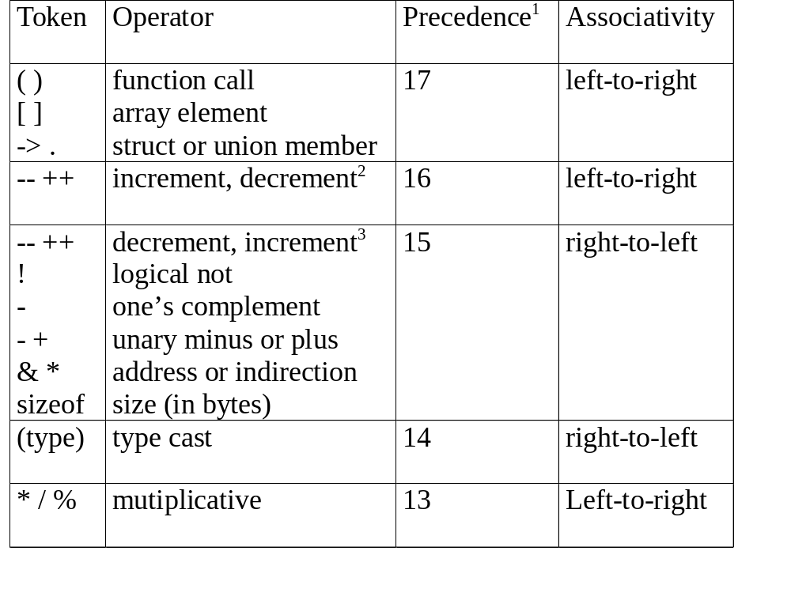

Slide 57
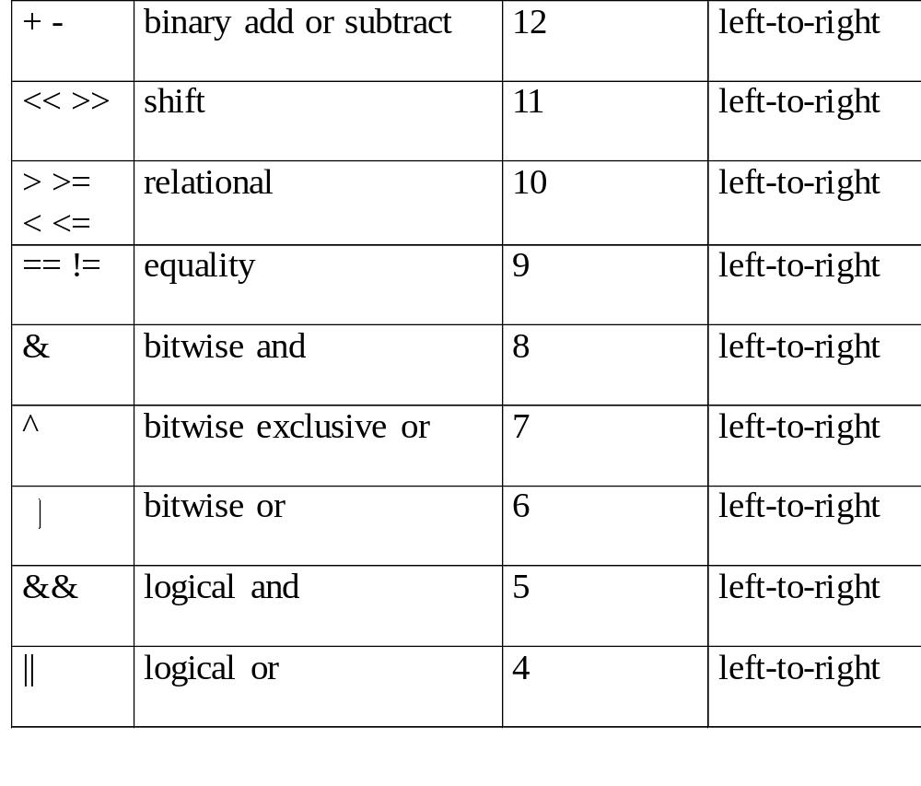

Slide 58
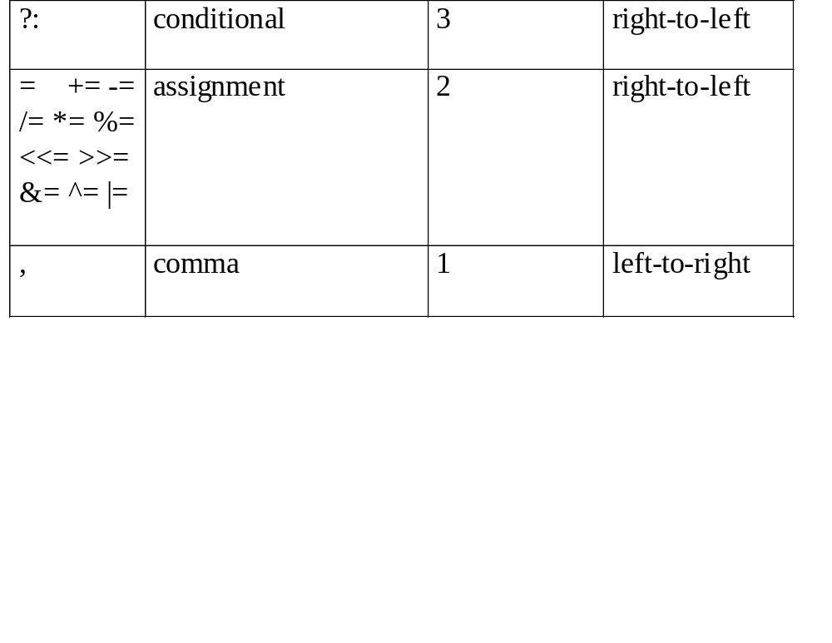

Slide 59
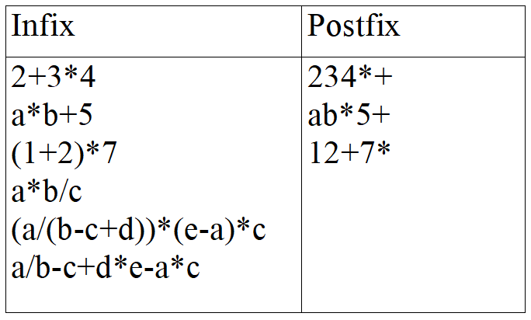
user
compiler
*Figure 3.13: Infix and postfix notation (p.120)
Postfix: no parentheses, no precedence

Slide 60
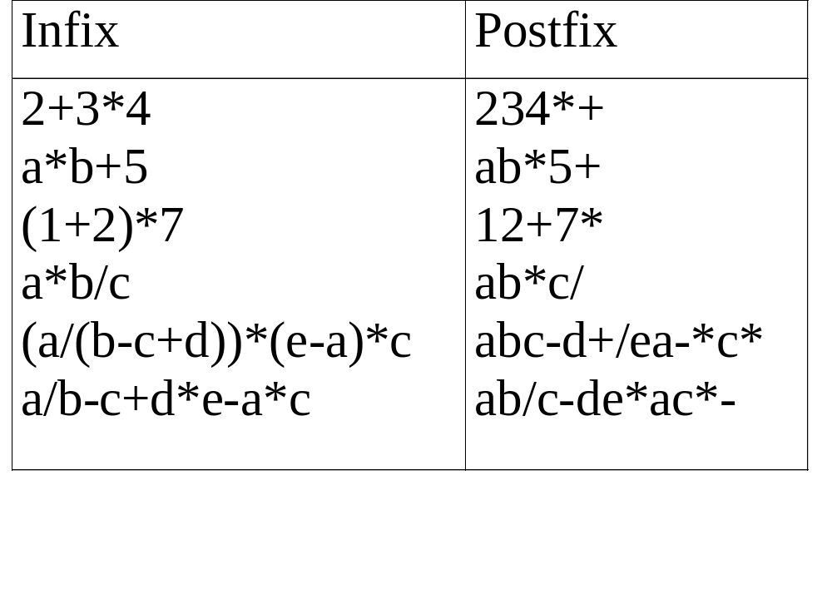
user
compiler
Postfix: no parentheses, no precedence

Slide 61
Infix to Postfix Conversion
(Intuitive Algorithm/ Manual method)
(1) Fully parenthesize expression
a / b - c + d * e - a * c -->
((((a / b) - c) + (d * e)) - a * c))
(2) All operators replace their corresponding right
parentheses.
((((a / b) - c) + (d * e)) - a * c))
(3) Delete all parentheses.
ab/c-de*+ac*-
two passes
/
-
+
-
*
*

Slide 62
Infix to postfix conversion: Sample Exercises
Convert the following infix expression to postfix expression
a+b*c+d*e
a*b+5
(a/(b-c+d))*(e-a)*c
a/b-c+d*e-a*c

Slide 63
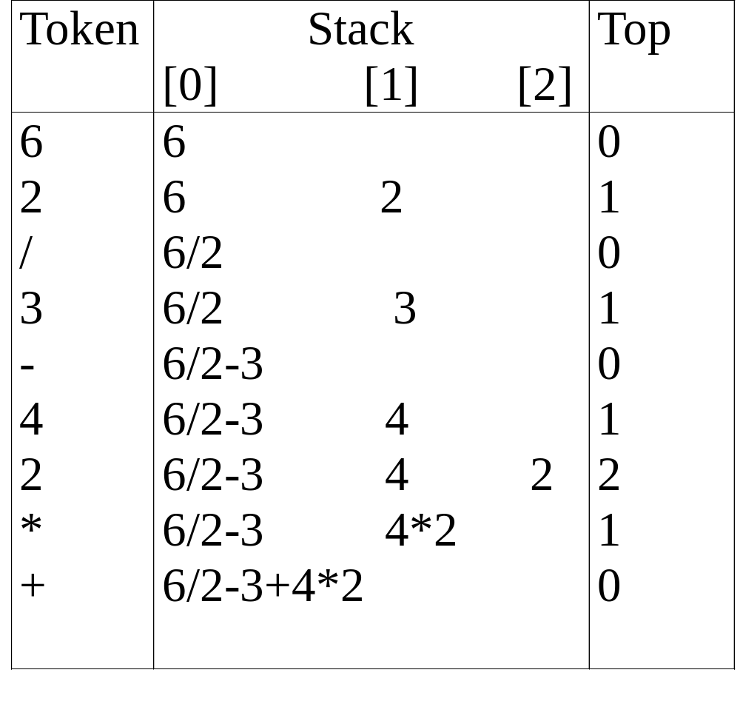
Evaluation of Postfix Using Stack

Slide 64
Evaluate postfix expression
Assumptions:
operators: +, -, *, /, % operands: single digit integer

Slide 65
Evaluate postfix expression
Assumptions:
operators: +, -, *, /, % operands: single digit integer
#define MAX_STACK_SIZE 100 /* maximum stack size */
#define MAX_EXPR_SIZE 100 /* max size of expression */
int stack[MAX_STACK_SIZE]; /* global stack */
char expr[MAX_EXPR_SIZE]; /* input string -- expression */

Slide 66
Evaluate postfix expression
Assumptions:
operators: +, -, *, /, % operands: single digit integer
#define MAX_STACK_SIZE 100 /* maximum stack size */
#define MAX_EXPR_SIZE 100 /* max size of expression */
typedef enum{lparan, rparen, plus, minus, times, divide,
mod, eos, operand} precedence;
int stack[MAX_STACK_SIZE]; /* global stack */
char expr[MAX_EXPR_SIZE]; /* input string -- expression */

Slide 67
int eval(void)
{
/* evaluate a postfix expression, expr, maintained as a
global variable,
‘\0’ is the the end of the expression.
The stack and top of the stack are global variables.
*/
}

Slide 68
int eval(void)
{
/* evaluate a postfix expression, expr, maintained as a
global variable,
‘\0’ is the the end of the expression.
The stack and top of the stack are global variables.
get_token() is used to return the token type and
the character symbol.
Operands are assumed to be single character digits */
}

Slide 69
precedence get_token(char *symbol, int *n)
{
/* get the next token,
symbol is the character representation, which is
returned,
the token is represented by its enumerated value, which
is returned in the function name */
}

Slide 70
int eval(void)
{
precedence token;
char symbol;
int op1, op2;
int n = 0; /* counter for the expression string */
int top = -1;
// Scan left to right
//If operand push (single digit)
// If operator pop 2 operands; push the op result
//If End of Expression, pop the result

Slide 71
int eval(void)
{
precedence token;
char symbol;
int op1, op2;
int n = 0; /* counter for the expression string */
int top = -1;
// Scan left to right
token = get_token(&symbol, &n);
while (token != eos) {
if (token == operand)
push(&top, symbol-’0’); /* push operand */

Slide 72
else {
/* operator: remove two operands*/
op2 = pop(&top);
op1 = pop(&top);
switch(token) { /* perform operation; result to stack */
case plus: push(&top, op1+op2); break;
case minus: push(&top, op1-op2); break;
case times: push(&top, op1*op2); break;
case divide: push(&top, op1/op2); break;
case mod: push(&top, op1%op2);
}
}
token = get_token (&symbol, &n);
} /* End of Expression*/
return pop(&top); /* return result from the stack */
}

Slide 73
precedence get_token(char *symbol, int *n)
{
*symbol =expr[(*n)++];
switch (*symbol) {
case ‘(‘ : return lparen;
case ’)’ : return rparen;
case ‘+’: return plus;
case ‘-’ : return minus;

Slide 74
case ‘/’ : return divide;
case ‘*’ : return times;
case ‘%’ : return mod;
case ‘\0‘ : return eos;
default : return operand;
/* no error checking, default is operand */
}
}

Slide 75
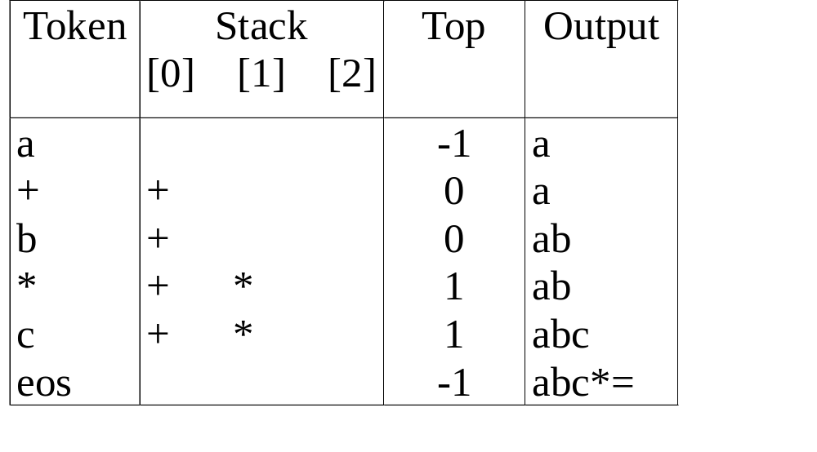
Infix to Postfix Conversion (Using Stack)
*Figure 3.15: Translation of a+b*c to postfix (p.124)
The orders of operands in infix and postfix are the same.
a + b * c, * > +

Slide 76
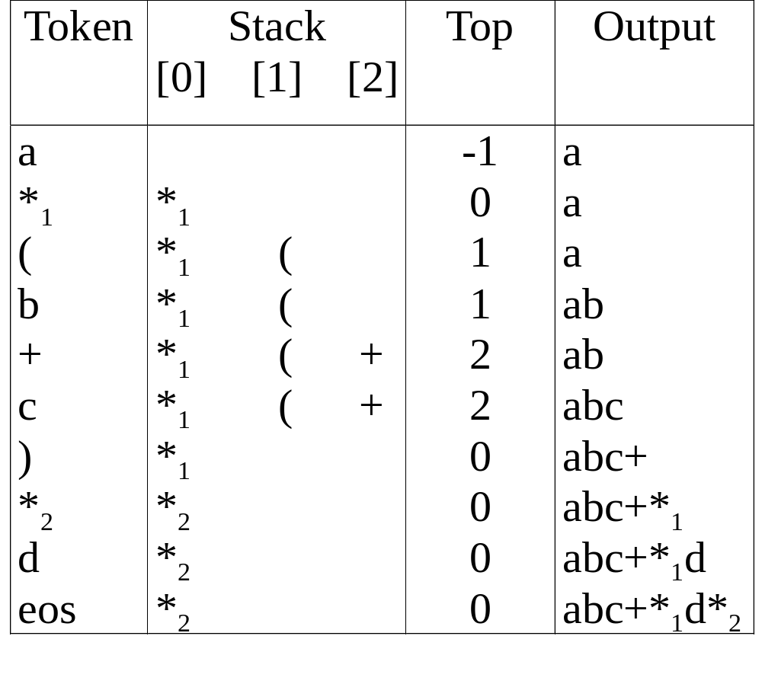
a *₁ (b +c) *₂ d
match )
*₁ = *₂
* Figure 3.16: Translation of a*(b+c)*d to postfix (p.124)

Slide 77
Rules
(1) Operators are taken out of the stack as long as their
in-stack precedence is higher than or equal to the
incoming precedence of the new operator.
(2) ( has low in-stack precedence, and high incoming
precedence.
( ) + - * / % eos
isp 0 19 12 12 13 13 13 0
icp 20 19 12 12 13 13 13 0

Slide 78
precedence stack[MAX_STACK_SIZE];
/* isp and icp arrays -- index is value of precedence
lparen, rparen, plus, minus, times, divide, mod, eos */
static int isp [ ] = {0, 19, 12, 12, 13, 13, 13, 0};
static int icp [ ] = {20, 19, 12, 12, 13, 13, 13, 0};
isp: in-stack precedence
icp: incoming precedence

Slide 79
void postfix(void)
{
/* output the postfix of the expression. The expression
string, the stack, and top are global */
char symbol;
precedence token;
int n = 0;
int top = 0; /* place eos on stack */
stack[0] = eos;
// Scan left to right
//If operand print.
else
//If rpar, unstack tokens and print until lpar;
discard lpar.
else remove and print symbols if isp>=icp else push()
//Unstack remaining symbols and print

Slide 80
void postfix(void)
{
/* output the postfix of the expression. The expression
string, the stack, and top are global */
char symbol;
precedence token;
int n = 0;
int top = 0; /* place eos on stack */
stack[0] = eos;
for (token = get _token(&symbol, &n); token != eos;
token = get_token(&symbol, &n)) {
if (token == operand)
printf (“%c”, symbol);

Slide 81
else if (token == rparen ){
/*unstack tokens until left parenthesis */
while (stack[top] != lparen)
print_token(pop(&top));
pop(&top); /*discard the left parenthesis */
}

Slide 82
else if (token == rparen ){
/*unstack tokens until left parenthesis */
while (stack[top] != lparen)
print_token(pop(&top));
pop(&top); /*discard the left parenthesis */
}
else{
/* remove and print symbols whose isp is greater
than or equal to the current token’s icp */
while(isp[stack[top]] >= icp[token] )
print_token(pop(&top));
push(&top, token);
}
}

Slide 83
while ((token = pop(&top)) != eos)
print_token(token);
print(“\n”);
}
*Program 3.11: Function to convert from infix to postfix (p.126)

Slide 84
Infix to postfix conversion using stack
Convert the following infix expression to postfix expression using a stack . Show the instances of stack during conversion.
a+b*c+d*e
a*b+5
((a/(b-c+d))*(e-a)*c
a/b-c+d*e-a*c

Slide 85
Multiple stacks and queues
Two stacks
m[0], m[1], …, m[n-2], m[n-1]
bottommost bottommost
stack 1 stack 2

Slide 86
Multiple stacks and queues
m[0], m[1], …, m[n-2], m[n-1]
More than two stacks (n)
memory is divided into n equal segments
boundary[stack_no]
0 ≤ stack_no < MAX_STACKS
top[stack_no]
0 ≤ stack_no < MAX_STACKS

Slide 87
Initially, boundary[i]=top[i].
0 1[ m/n ] 2[ m/n ] m-1
boundary[ 0] boundary[1] boundary[ 2] boundary[n]
top[ 0] top[ 1] top[ 2]
All stacks are empty and divided into roughly equal segments.
*Figure 3.18: Initial configuration for n stacks in memory [m]. (p.129)

Slide 88
#define MEMORY_SIZE 100 /* size of memory */
#define MAX_STACKS 10
/* max number of stacks plus 1 */
/* global memory declaration */
element memory[MEMORY_SIZE];
int top[MAX_STACKS];
int boundary[MAX_STACKS];
int n; /* number of stacks entered by the user */

Slide 89
#define MEMORY_SIZE 100 /* size of memory */
#define MAX_STACKS 10
/* max number of stacks plus 1 */
/* global memory declaration */
element memory[MEMORY_SIZE];
int top[MAX_STACKS];
int boundary[MAX_STACKS];
int n; /* number of stacks entered by the user */
*(p.128)
top[0] = boundary[0] = -1;
for (i = 1; i < n; i++)
top[i] =boundary[i] =(MEMORY_SIZE/n)*i;
boundary[n] = MEMORY_SIZE-1;
*(p.129)

Slide 90
top[0] = boundary[0] = -1;
for (i = 1; i < n; i++)
top[i] =boundary[i] =(MEMORY_SIZE/n)*i;
boundary[n] = MEMORY_SIZE-1;
*(p.129)

Slide 91
void push(int i, element item)
{
/* add an item to the ith stack */
if (top[i] == boundary [i+1])
stack_full(i); may have unused storage
memory[++top[i]] = item;
}
*Program 3.12:Add an item to the stack stack-no (p.129)

Slide 92
void add(int i, element item)
{
/* add an item to the ith stack */
if (top[i] == boundary [i+1])
stack_full(i); may have unused storage
memory[++top[i]] = item;
}
*Program 3.12:Add an item to the stack stack-no (p.129)
element pop(int i)
{
/* remove top element from the ith stack */
if (top[i] == boundary[i])
return stack_empty(i);
return memory[top[i]--];
}
*Program 3.13:Delete an item from the stack stack-no (p.130)

Slide 93
element pop(int i)
{
/* remove top element from the ith stack */
if (top[i] == boundary[i])
return stack_empty(i);
return memory[top[i]--];
}
*Program 3.13:Delete an item from the stack stack-no (p.130)

Slide 94
Find j, i < j < n
such that top[j] < boundary[j+1]
or, 0 ≤ j < i
b[0] t[0] b[1] t[1] b[i] t[i] t[i+1] t[j] b[j+1] b[n]
b[i+1] b[i+2]
b=boundary, t=top
*Figure 3.19: Configuration when stack i meets stack i+1,
but the memory is not full (p.130)
meet

Slide 95
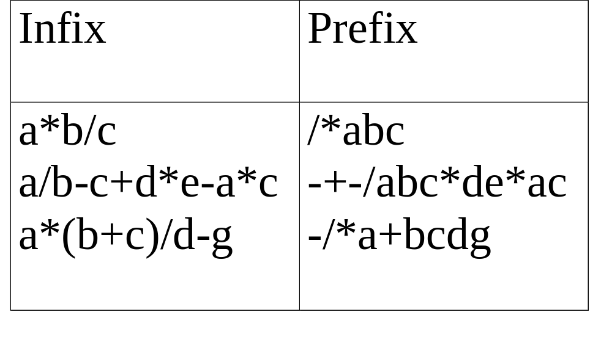
(1) evaluation
(2) transformation
*Figure 3.17: Infix and postfix expressions (p.127)

Slide 96
Input : A * B + C / D Output : + * A B/ C D Input : (A - B/C) * (A/K-L) Output : *-A/BC-/AKL
Infix to Prefix
e.g., Infix: A*B+C/D
Infix: (A-B/C)*(A/K-L)

Slide 97
Input : A * B + C / D Output : + * A B/ C D Input : (A - B/C) * (A/K-L) Output : *-A/BC-/AKL
Infix to Prefix
e.g., Infix: A*B+C/D Prefix: +*AB/CD
Infix: (A-B/C)*(A/K-L) Prefix: *-A/BC-/AKL

Slide 98
Input : A * B + C / D Output : + * A B/ C D Input : (A - B/C) * (A/K-L) Output : *-A/BC-/AKL
Infix to Prefix
e.g., Infix: A*B+C/D Prefix: +*AB/CD
Infix: (A-B/C)*(A/K-L) Prefix: *-A/BC-/AKL
Step 1: Reverse the infix expression i.e A+B*C will become C*B+A.
Note while reversing each ‘(‘ will become ‘)’ and each ‘)’ becomes ‘(‘.
Step 2: Obtain the postfix expression of the modified expression
i.e CB*A+.
Step 3: Reverse the postfix expression.
Hence in our example prefix is +A*BC

Slide 99
Input : A * B + C / D Output : + * A B/ C D Input : (A - B/C) * (A/K-L) Output : *-A/BC-/AKL
Infix(A) to Prefix(B)
Step 1. Push “)” onto STACK, and add “(“ to end of the A
Step 2. Scan A from right to left and repeat step 3 to 6
for each element of A until the STACK is empty

Slide 100
Input : A * B + C / D Output : + * A B/ C D Input : (A - B/C) * (A/K-L) Output : *-A/BC-/AKL
Infix to Prefix
Step 1. Push “)” onto STACK, and add “(“ to end of the A
Step 2. Scan A from right to left and repeat step 3 to 6
for each element of A until the STACK is empty
Step 3. If an operand is encountered add it to B
Step 4. If a right parenthesis is encountered push it onto STACK

Slide 101
Input : A * B + C / D Output : + * A B/ C D Input : (A - B/C) * (A/K-L) Output : *-A/BC-/AKL
Infix to Prefix
Step 1. Push “)” onto STACK, and add “(“ to end of the A
Step 2. Scan A from right to left and repeat step 3 to 6
for each element of A until the STACK is empty
Step 3. If an operand is encountered add it to B
Step 4. If a right parenthesis is encountered push it onto STACK
Step 5. If an operator is encountered then:
Repeatedly pop from STACK and add to B each operator
(on the top of STACK) which has same
or higher precedence than the operator.
b. Add operator to STACK

Slide 102
Input : A * B + C / D Output : + * A B/ C D Input : (A - B/C) * (A/K-L) Output : *-A/BC-/AKL
Infix to Prefix
Step 1. Push “)” onto STACK, and add “(“ to end of the A
Step 2. Scan A from right to left and repeat step 3 to 6
for each element of A until the STACK is empty
Step 3. If an operand is encountered add it to B
Step 4. If a right parenthesis is encountered push it onto STACK
Step 5. If an operator is encountered then:
Repeatedly pop from STACK and add to B each operator
(on the top of STACK) which has higher precedence than
the operator.
b. Add operator to STACK
Step 6. If left parenthesis is encountered then
Repeatedly pop from the STACK and add to B
(each operator on top of stack until a right parenthesis is encountered)
b. Remove the right parenthesis
Step 7. Reverse A

Slide 103
Input : A * B + C / D Output : + * A B/ C D Input : (A - B/C) * (A/K-L) Output : *-A/BC-/AKL
Infix to Prefix
e.g., Infix: A*B+C/D Prefix: +*AB/CD
Infix: (A-B/C)*(A/K-L) Prefix: *-A/BC-/AKL

Slide 104
(1) evaluation
(2) transformation
*Figure 3.17: Infix and postfix expressions (p.127)

Slide 105
Input : A * B + C / D Output : + * A B/ C D Input : (A - B/C) * (A/K-L) Output : *-A/BC-/AKL
Prefix to Postfix
Read the Prefix expression in reverse order
(from right to left)
If the symbol is an operand,
then push it onto the Stack

Slide 106
Input : A * B + C / D Output : + * A B/ C D Input : (A - B/C) * (A/K-L) Output : *-A/BC-/AKL
Prefix to Postfix
Read the Prefix expression in reverse order
(from right to left)
If the symbol is an operand,
then push it onto the Stack
If the symbol is an operator,
then pop two operands from the Stack
Create a string by concatenating the two operands
and the operator after them.
string = operand1 + operand2 + operator
And push the resultant string back to Stack

Slide 107
Input : A * B + C / D Output : + * A B/ C D Input : (A - B/C) * (A/K-L) Output : *-A/BC-/AKL
Prefix to Postfix
Read the Prefix expression in reverse order
(from right to left)
If the symbol is an operand,
then push it onto the Stack
If the symbol is an operator,
then pop two operands from the Stack
Create a string by concatenating the two operands
and the operator after them.
string = operand1 + operand2 + operator
And push the resultant string back to Stack
Repeat the above steps
until end of Prefix expression.

Slide 108
Input : A * B + C / D Output : + * A B/ C D Input : (A - B/C) * (A/K-L) Output : *-A/BC-/AKL
Evaluation of Prefix expression
Hint: Scan the expression from right to left
e.g., +*abc

Slide 109
Circular Queue using Dynamically Allocated Arrays
FULL QUEUE FULL QUEUE
[2] [3] [2] [3]
J2 J3
J8 J9
J7
[1] [4][1] [4]
J1 J4
J5
J6 J5
[0] [5] [0] [5]
front =0
rear = 5
front =4
rear =3

Slide 110
Input : A * B + C / D Output : + * A B/ C D Input : (A - B/C) * (A/K-L) Output : *-A/BC-/AKL
Circular Queue using Dynamically Allocated Arrays
void addq(element item)
{
………………
queueFull();
………………….
}

Slide 111
Input : A * B + C / D Output : + * A B/ C D Input : (A - B/C) * (A/K-L) Output : *-A/BC-/AKL
Circular Queue using Dynamically Allocated Arrays
void queueFull()
{ /*allocate an array with twice the capacity*/
/* Copy from queue to newQueue*/
/* Switch to newQueue
}

Slide 112
Input : A * B + C / D Output : + * A B/ C D Input : (A - B/C) * (A/K-L) Output : *-A/BC-/AKL
Circular Queue using Dynamically Allocated Arrays
void queueFull()
{ /*allocate an array with twice the capacity*/
Element * newQueue;
newQueue = (newQueue*) (2*capacity * sizeof(*queue));
/* Copy from queue to newQueue*/
/* Switch to newQueue
}

Slide 113
Input : A * B + C / D Output : + * A B/ C D Input : (A - B/C) * (A/K-L) Output : *-A/BC-/AKL
Circular Queue using Dynamically Allocated Arrays
void queueFull()
{ /*allocate an array with twice the capacity*/
/* Copy from queue to newQueue*/
Start = (front+1) % capacity;
If (Start < 2) /* No wrap around */
{…}
Else /* wrap around */
{…}
/* Switch to newQueue
}

Slide 114
Input : A * B + C / D Output : + * A B/ C D Input : (A - B/C) * (A/K-L) Output : *-A/BC-/AKL
Circular Queue using Dynamically Allocated Arrays
void queueFull()
{ /*allocate an array with twice the capacity*/
/* Copy from queue to newQueue*/
Start = (front+1) % capacity;
If (Start < 2) /* No wrap around */
copy(queue+start, queue+capacity-1, newQueue);
Else /* wrap around */
{copy(queue+start, queue+capacity, newQueue);
copy(queue, queue+rear-1, newQueue);
}
/* Switch to newQueue
}

Slide 115
Input : A * B + C / D Output : + * A B/ C D Input : (A - B/C) * (A/K-L) Output : *-A/BC-/AKL
Circular Queue using Dynamically Allocated Arrays
void queueFull()
{ /*allocate an array with twice the capacity*/
/* Copy from queue to newQueue*/
/* Switch to newQueue
front = 2*capacity-1;
rear = capacity -2;
capacity *= 2;
free(queue);
queue = newQueue;
}

